Slide 1


Integrating a GUI for Metabolic Modeling and Dynamic Data Visualization
SEDS 546 Project:
“2nd-Best-FRENDAs”
Karl Anderson, Yejun Kim, Amanda Robert, Kingsley Wong

Slide 2
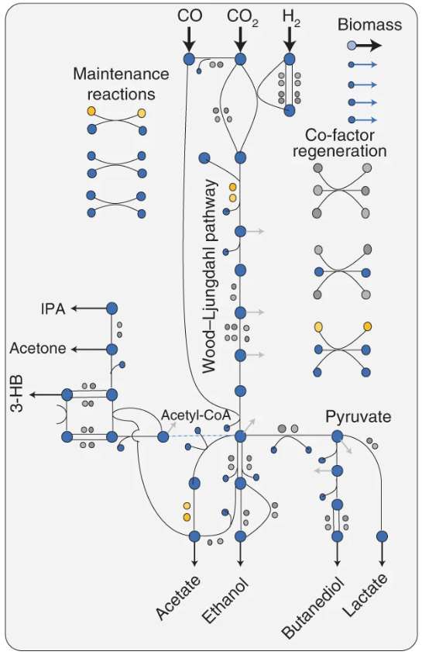

Background and Motivation
Cell-free systems are a low cost, short timescale methodology for in vitro transcription/translation (DNA->RNA->protein)
Useful for prototyping pathways, enzymes, co-factors, engineering strains.
Improve pathway flux to desired compound, cut out undesired products, etc.
Problems
High number of variables
Difficult to predict downstream effects
In vitro behavior can differ from in vivo
A model to predict perturbation effects would be great!!!
(Liew, F.E., Nogle, R., Abdalla, T. et al. 2022) https://doi.org/10.1038/s41587-021-01195-w

Slide 3
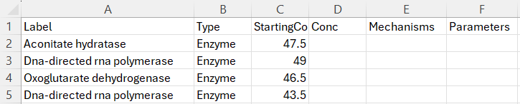

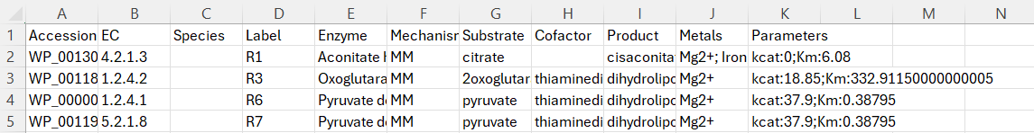
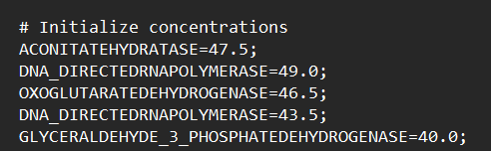
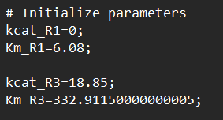
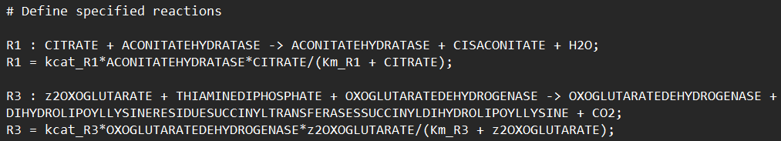
Previous Work and Development
SpeciesBaseFile.csv
FRENDA-
Reaction.csv
ODBM
model.xml/txt
Notes:
BRENDA: online database with comprehensive information about enzymes. Is cumbersome to look up every enzyme used in a reaction
FRENDA-BRENDA: tool that interfaces w an excel sheet containing all enzyme/metabolite names, and pulls kinetic data from BRENDA database (automated searching)
ODBM: takes output and constructs SBML and tellurium compatible script that can be simulated further

Slide 4
Project Introduction and Deliverables
Objective: Visualize metabolic models and induce system perturbations in real-time to predict experimental outcomes.
Need a robust way to perturb the model, re-solve ODEs, and visualize changes
Step 1: Obtain proteomic and kinetic data
(FRENDA-BRENDA outputs two .csv files)
Step 2: Run through ODBM to build SBML/Antimony files
Step 3:
Graphical User Interface for solving and graphing metabolic models.
*Proteomic and kinetic data can be obtained from online databases (Biomodels)
Notes:
Step 1: proteomic data of desired pathways returned as a csv/excel file containing reaction IDs, products and substrates from websites like Kegg. Kinetic parameters are pulled from online database BRENDA
Step 2: Users able to define their species, reactions, and mechanisms which is easily converted into proper tellurium syntax
Step 3: Upload file to GUI and let it do all the work for you :D

Slide 5
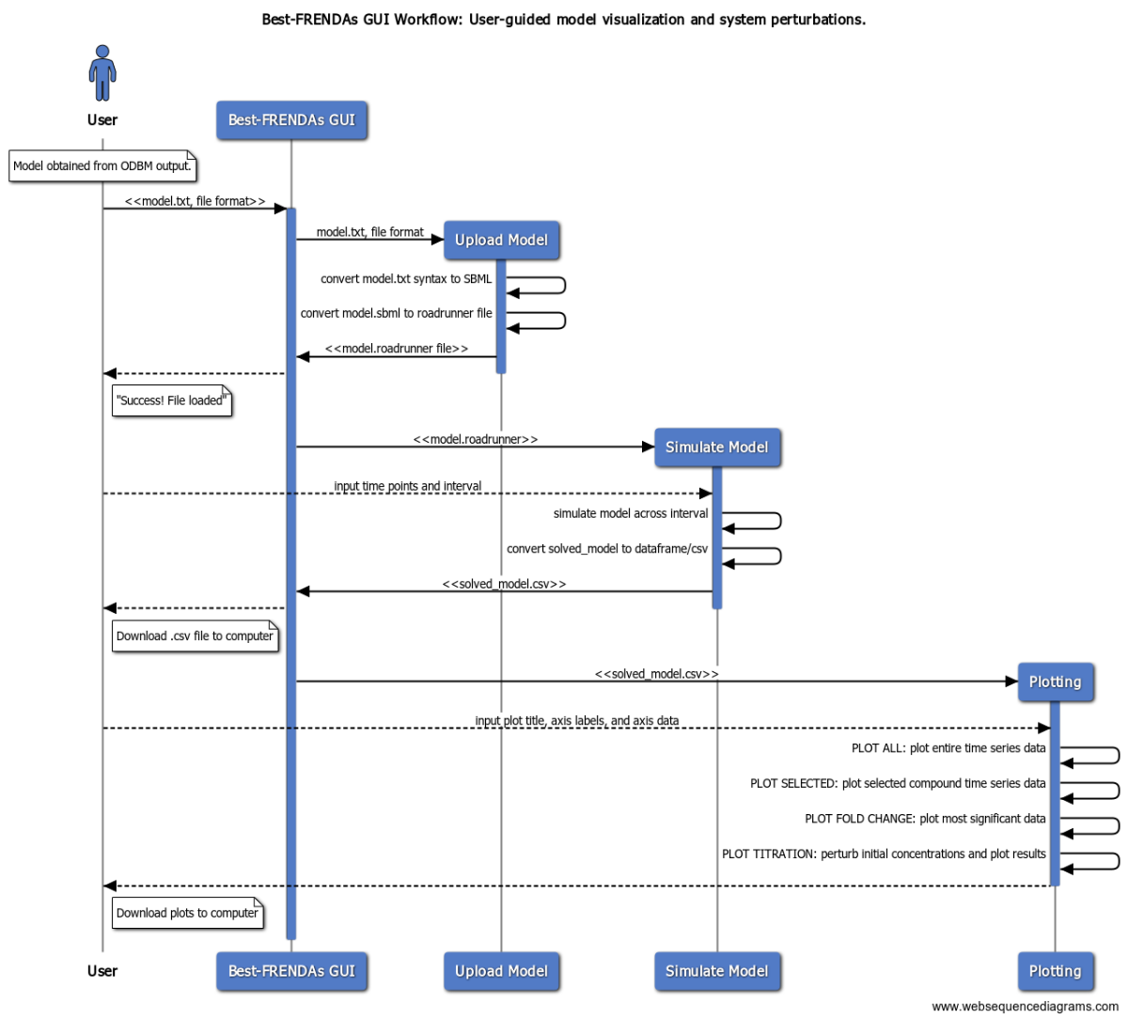
Notes:
Representation of how user interacts with GUI across tabs.
Input model file and file type
Get feedback its good
Input simulation steps and time interval
Get simulation output as csv
Input plotting preferences / interact across different plotting functions
Can download plots as desired
Can go back to simulate
Without the interface, user would have to go all the way back to the initial file, find metabolite in excel file, add/remove metabolite or change its concentration, rerun ODBM, get another output file to visualize. Saves user a lot of time just do have it automated in the GUI!

Slide 6
Summary of Software and Packages
Metabolic Modeling
GUI
FRENDA-BRENDA
Streamlit
ODBM
Plotly
Tellurium
NumPy
escher
pandas
Notes:
Hypothetically, biomodels can be used to be obtain kinetic data for endogenous pathways (i.e., glycolysis)
We used it to test our GUI on another file format, SBML

Slide 7
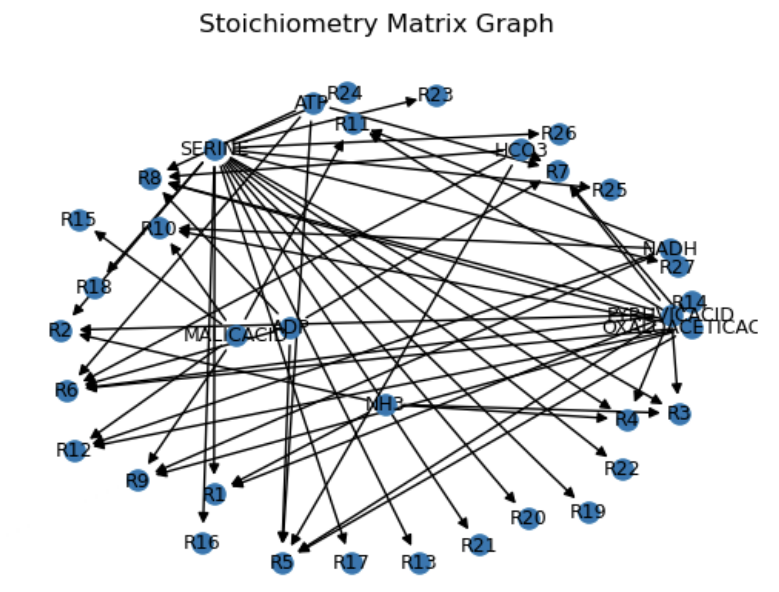
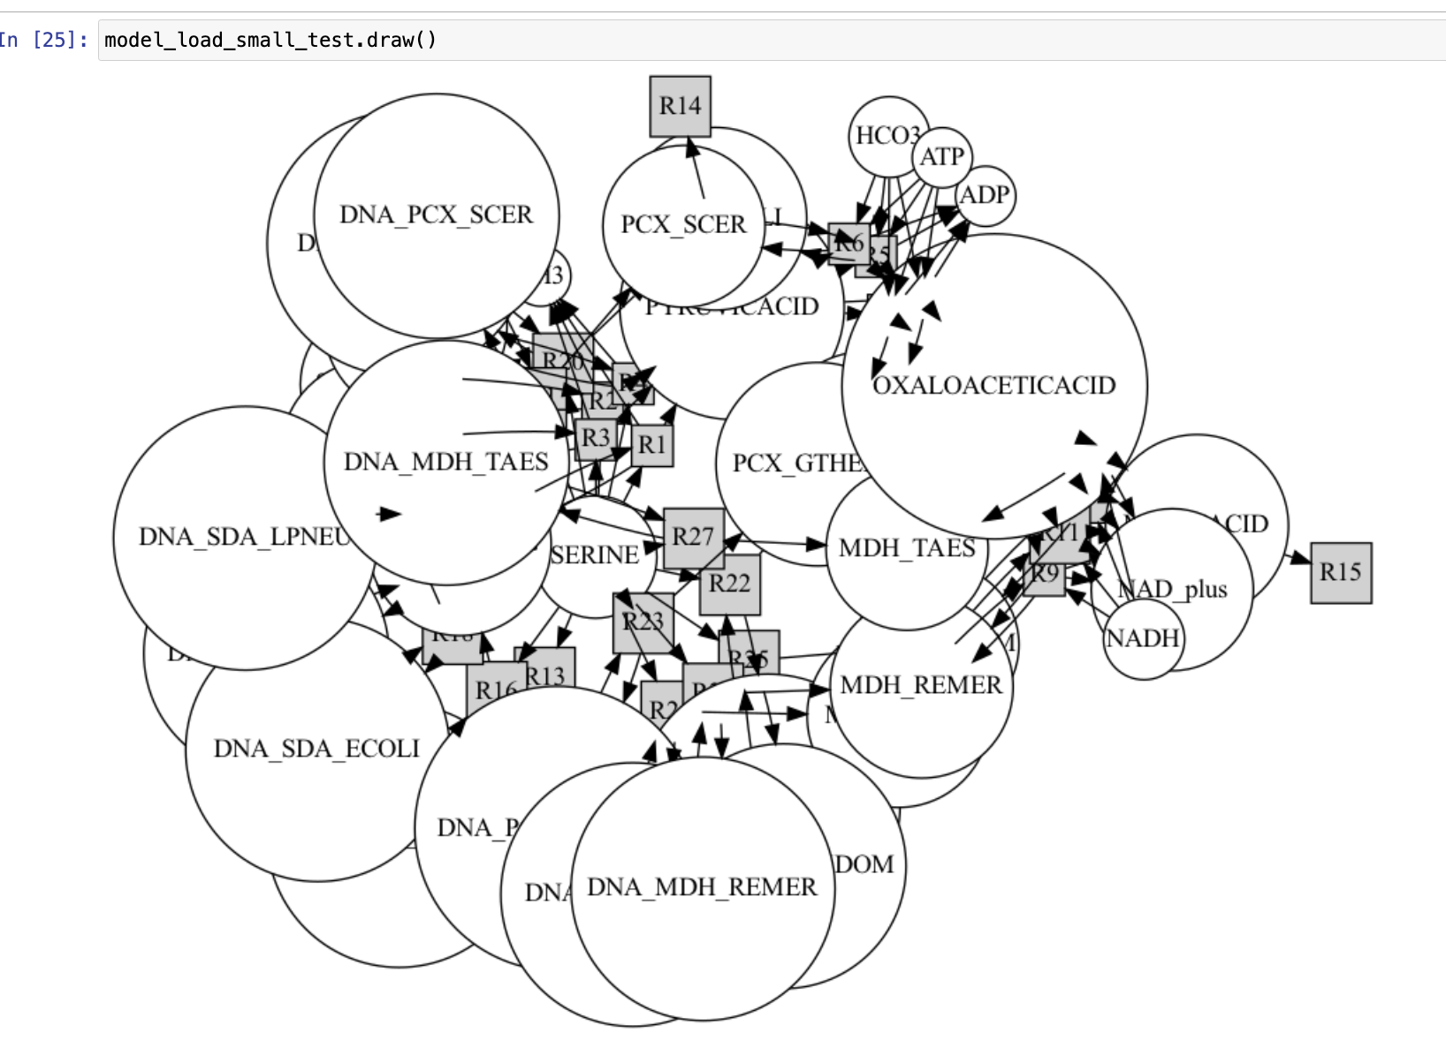
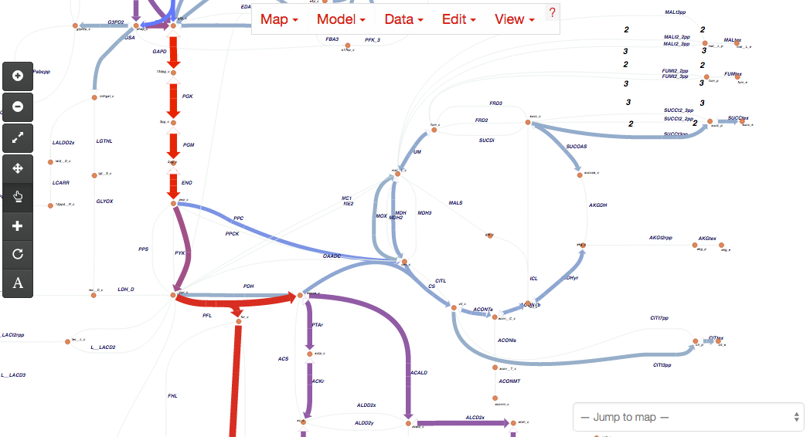
Metabolic Maps: current state and aspirations
Initial
Current
Future
Tellurium:
Hard to interpret and difficult to customize
NetworkX:
Hard to interpret in current state, but easy to implement and opportunities to adjust
Escher:
Aesthetic, but currently requires pre-drawn maps
Future Goal: Automatic mapping of synthetic pathways that represents flux through a pathway.
Notes:
Initially tried built in mapping function in tellurium, which we use for solving ODEs.
Then we moved to NetworkX, that has more customizability.
A future goal is to use a package like escher, but will need method of generating maps automatically.

Slide 8
Challenges and Future Work
Fully automating workflow: reduce user file handling between different pieces of software
Make GUI capable of adding metabolites and enzymes to model without having user edit original file
Handling endogenous pathways
Numerous endogenous pathways/side reactions affect modeling, and should be considered when determining kinetic parameters
Program struggles with larger files (~400 compounds, ~400 rxns)
Dynamic mapping: generate gifs/videos on maps to visualize flux through pathways
Metabolic mapping using Escher: compatibility issues with Java and python
Very difficult to parse through all the metadata

Slide 9

Acknowledgements
“Sometimes you have to settle for 2nd-best-FRENDAs”
You
Best-FRENDAs from the Carothers Lab:
Maggie Cook
Diego Alba Burbano
Best-FRENDAs from SEDS 546:
Dave Beck
Nels Schimek
Thank you!
“Don’t forgit to spend time with your FRENDAs over Spring Break”

Slide 10
SUPPLEMENTARY

Slide 11
Supplemental Slides
Previous Work and Development
Created a tool to pull online kinetic data and convert into a dynamic model.
BRENDA: enzyme database
Vmax, kcat, etc.
FRENDA-BRENDA: software developed by Carothers lab
Input: sheet of enzymes/metabolites of desired biological pathway
Quickly parses BRENDA and outputs reactions, species involved, and kinetic parameters in one file (e.g., Reaction.csv)
ODBM (Optimization of Dynamic Bioconversion Modules): software developed by Carothers lab
Input: FRENDA-BRENDA output
Solves reaction ODE’s using tellurium to generate predicted concentrations over time range
Reaction.csv
Notes:
ODBM: Optimization of Dynamic Bioconversion Modules
Interfaces w an excel input, and automatically constructs SBML (systems biology markuplanguage) model with tellurium
It does cell-free TXTL biocatalysis modeling, mechanistic model for central dogma, dynamic process control
Output a string file that is Tellurium compatible, and then can be simulated using roadrunner

Slide 12
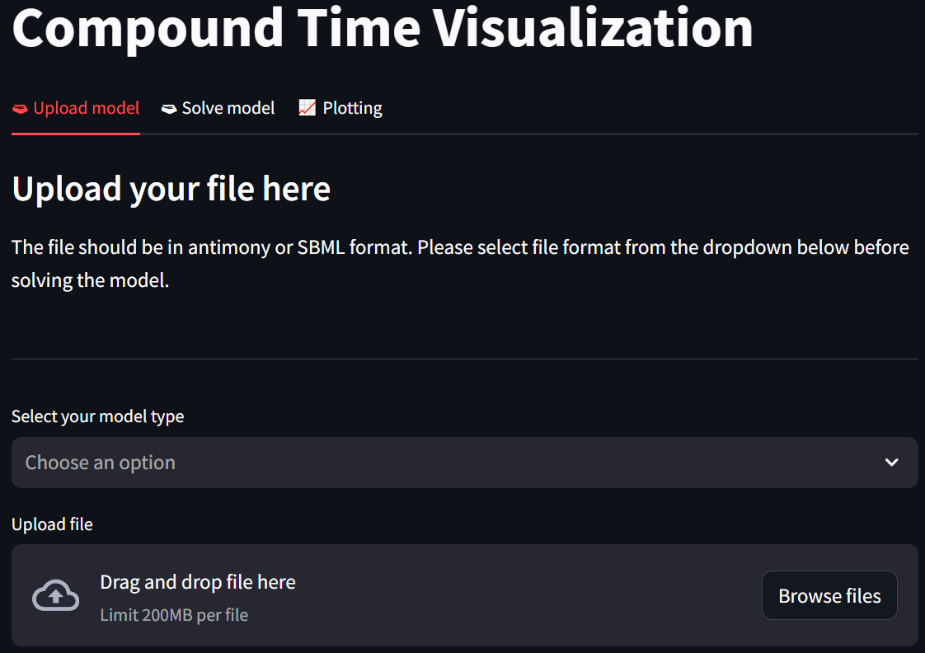
Supplemental Slides
Upload File

Slide 13
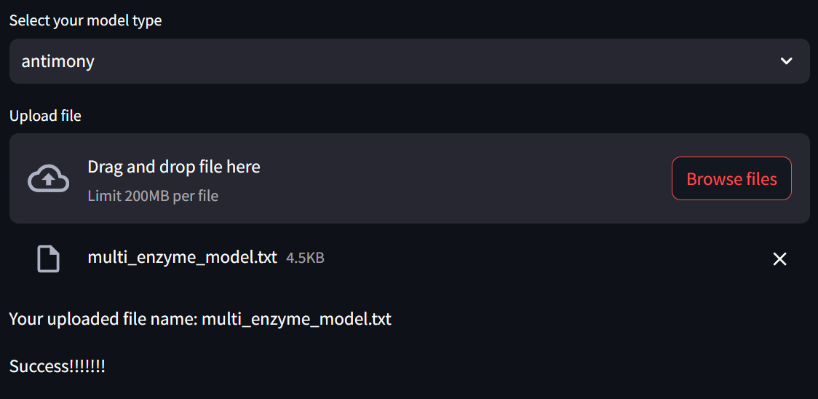
Upload File

Slide 14
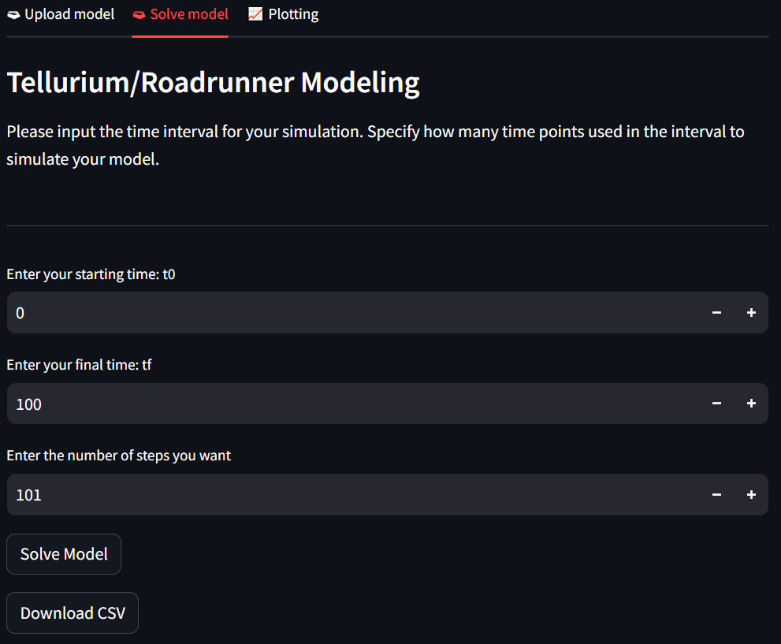
Supplemental Slides
Model Load

Slide 15
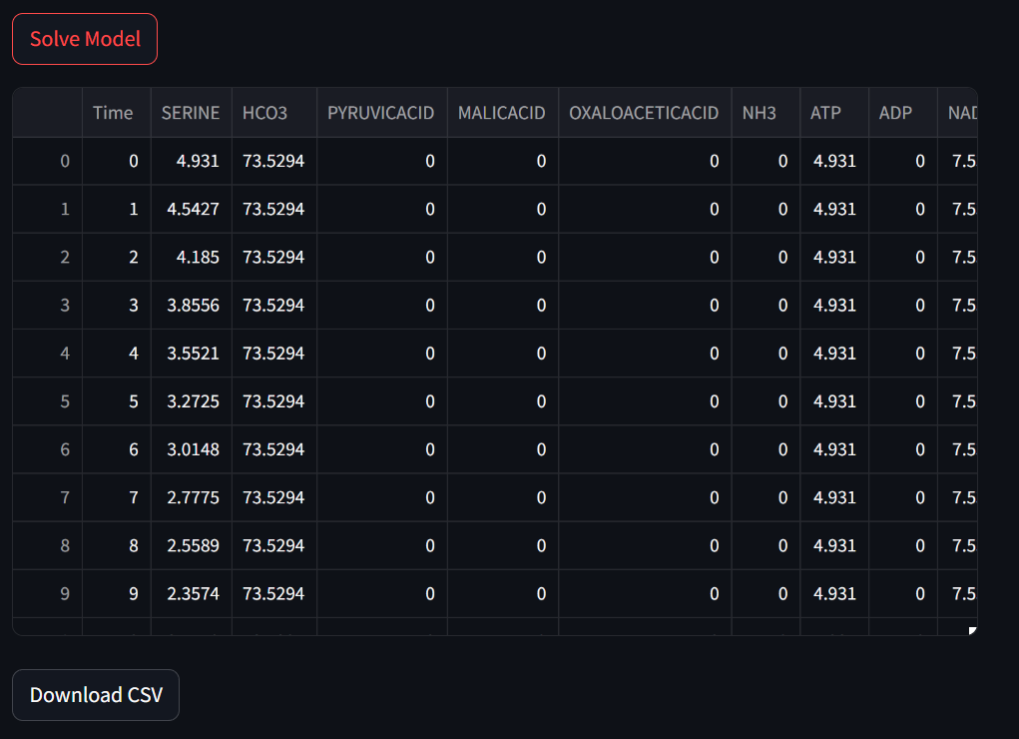
Supplemental Slides
Model Load

Slide 16
Supplemental Slides
Model Load

Slide 17
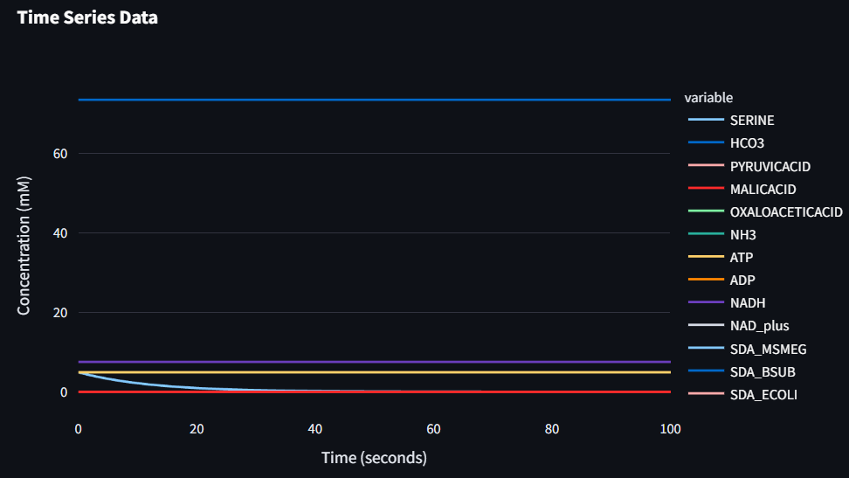
Supplemental Slides
Plot All

Slide 18
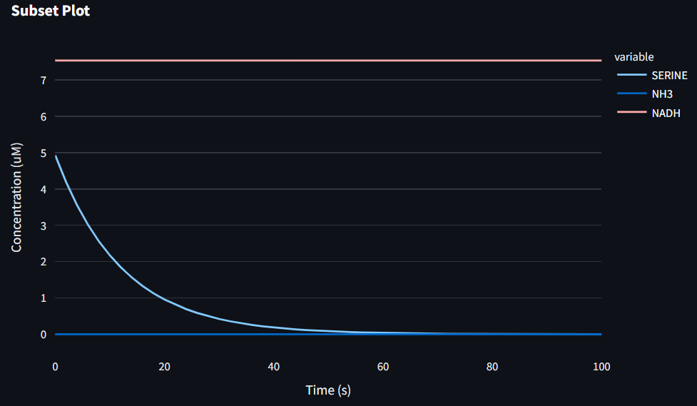
Supplemental Slides
Plot Subset

Slide 19
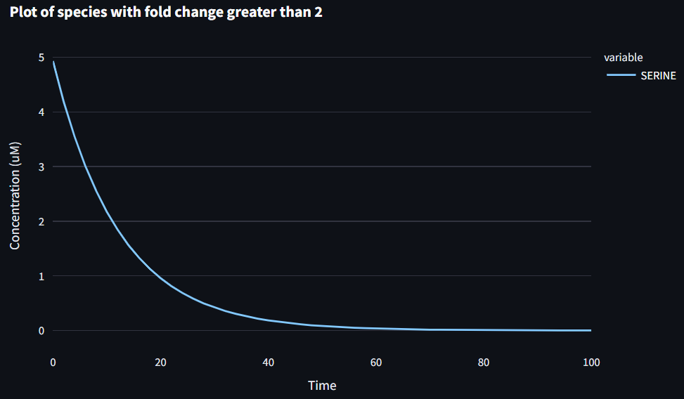
Supplemental Slides
Plot Fold Change

Slide 20
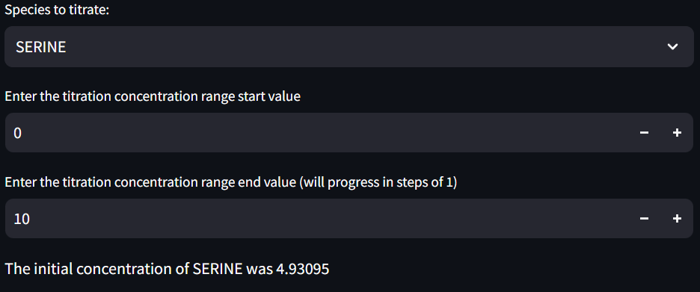
Supplemental Slides
Titration Plot

Slide 21
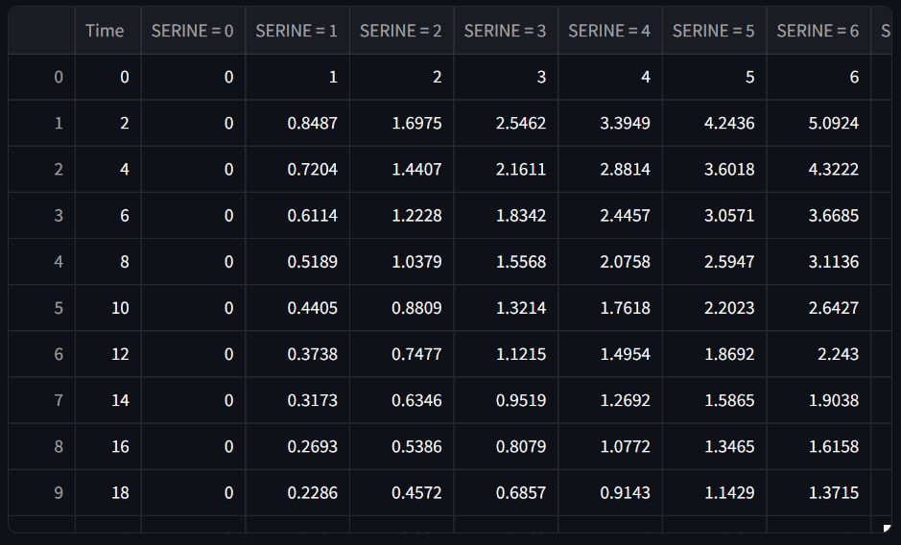
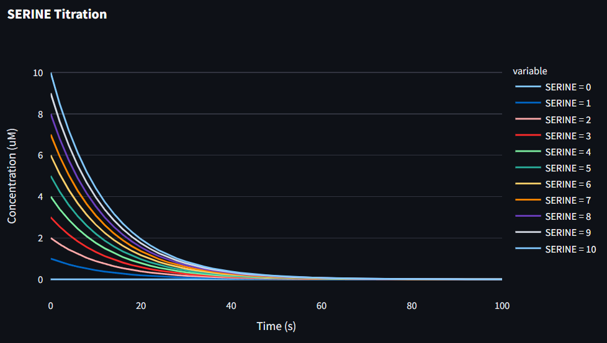
Supplemental Slides
Titration Plot

Slide 22
Supplemental Slides
Titration Plot

